Slide 1
COMP90007 Internet Technologies Workshop
Week 8 – Transport Layer
Ruixi
huor@student.unimelb.edu.au

Slide 2
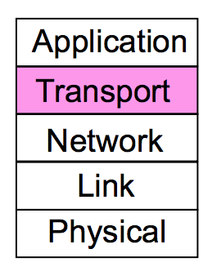
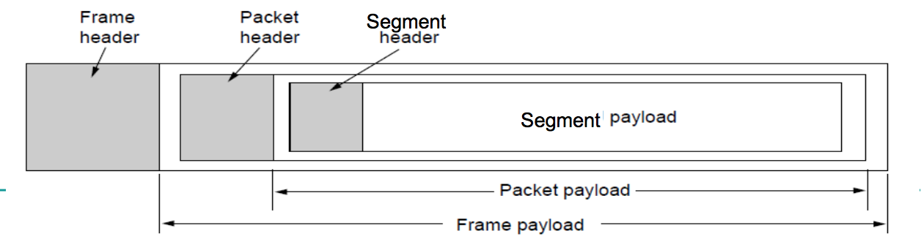
Review
segment
packet
frame
Encapsulation

Slide 3

Service
The ultimate goal of the transport layer is to provide efficient, reliable, and cost-effective data transmission service to its users, normally processes in the application layer.
To achieve this, the transport layer makes use of the services provided by the network layer.
2 types of services

Slide 4
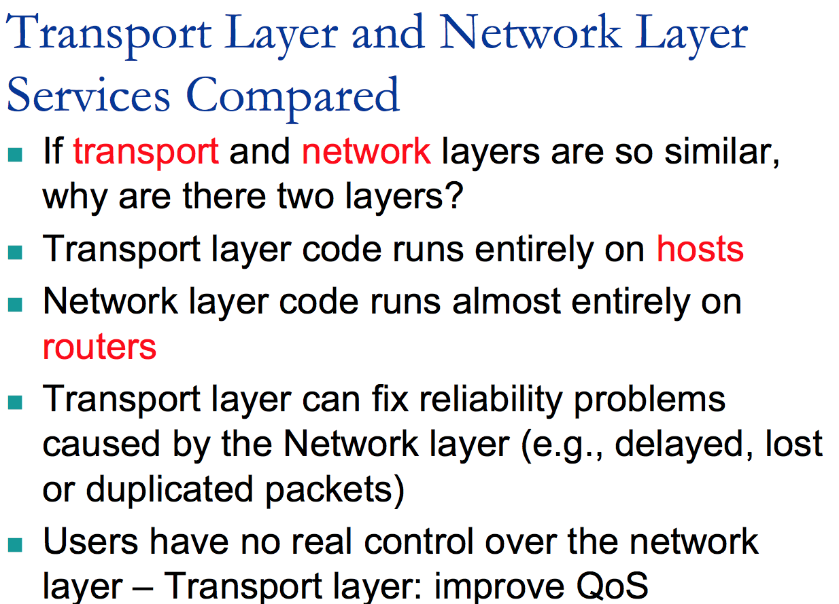

Slide 5
Connection-Oriented Service
Connection establishment -- Three Way Handshake
Host 1
Host 2
CR (seq = x)
SYN-ACK (ack = x+1, seq = y)
Time
ACK (ack = y+1, seq = x+1)
Data

Slide 6
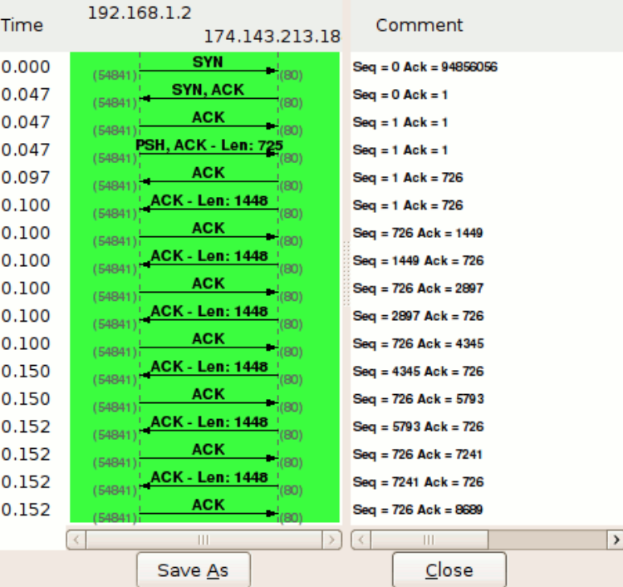
How sequence and acknowledgement numbers work
client
host
Notes:
TCP flow

Slide 7
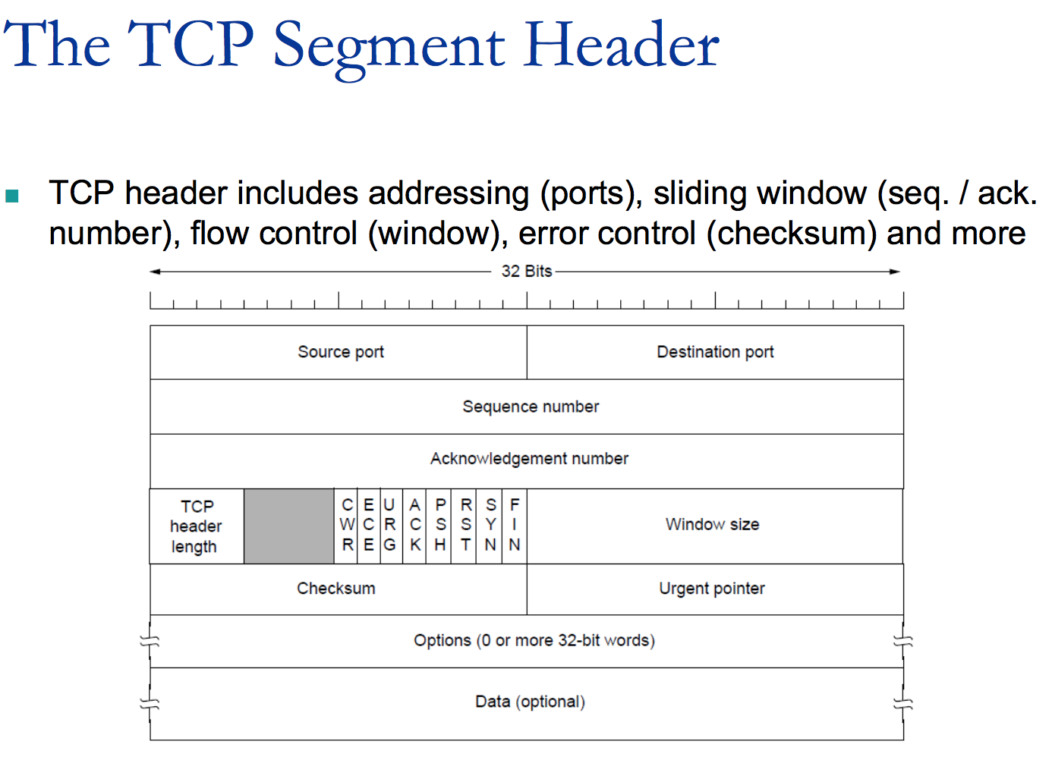
Notes:
8 Flags
Each flag has 1 bit.
If this is SYN segment, we just set SYN flag to 1, and the other 7 bits to 0.

Slide 8
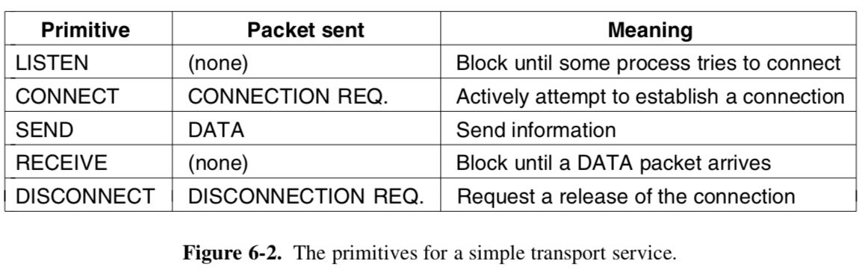
Connection-Oriented Service
Transport layer provides application developer abstraction/primitives to simplify the work

Slide 9
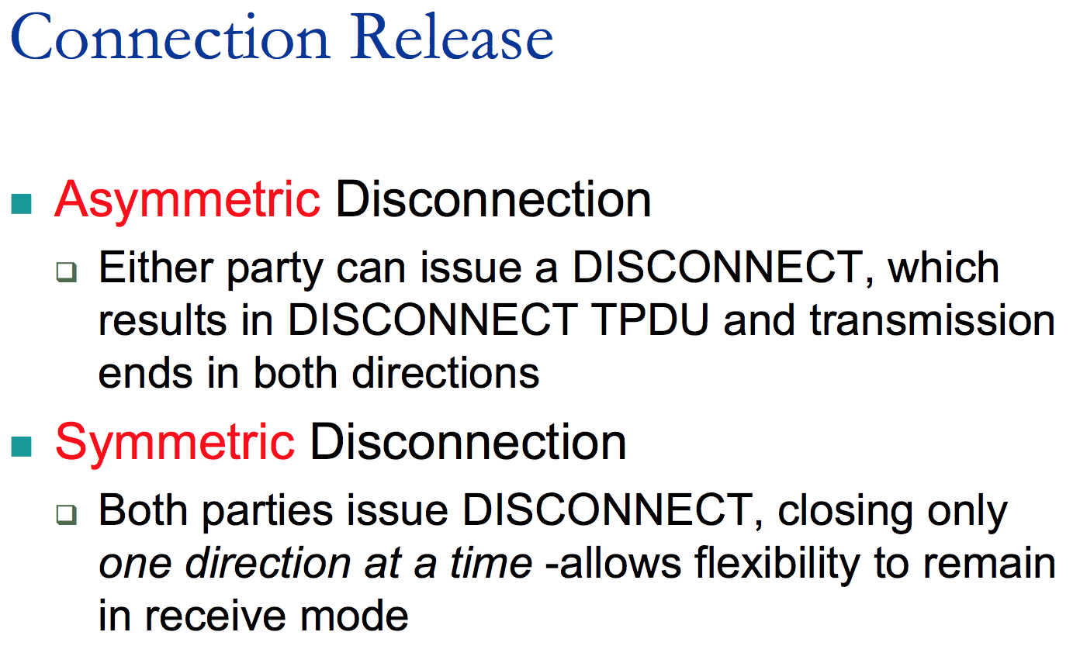

Slide 10
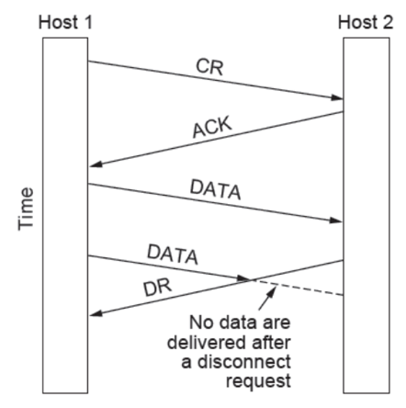
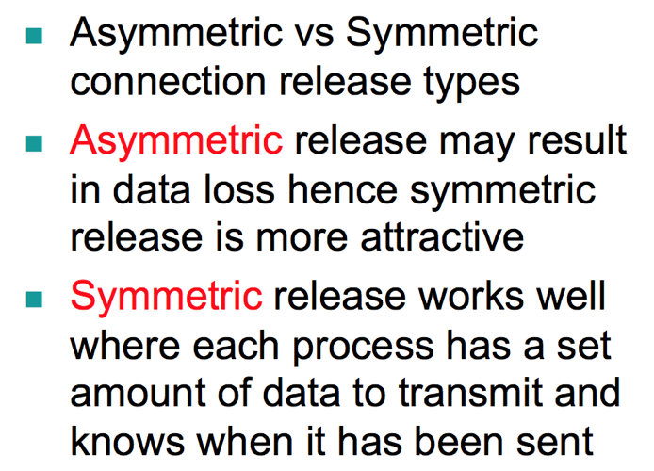
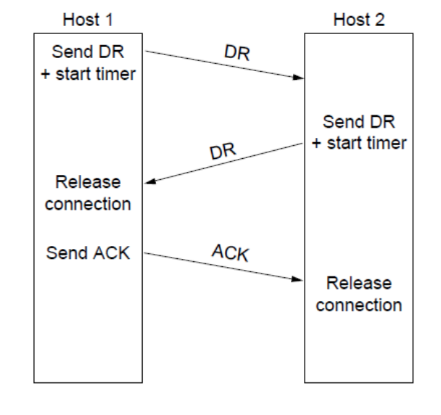

Slide 11
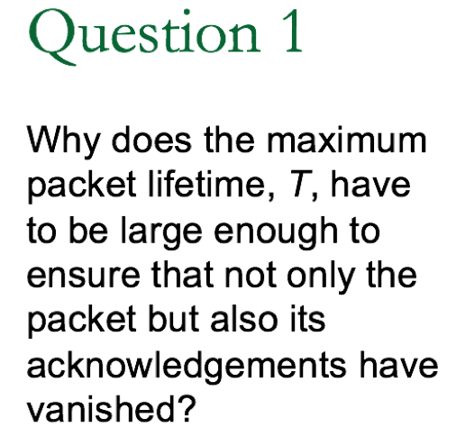
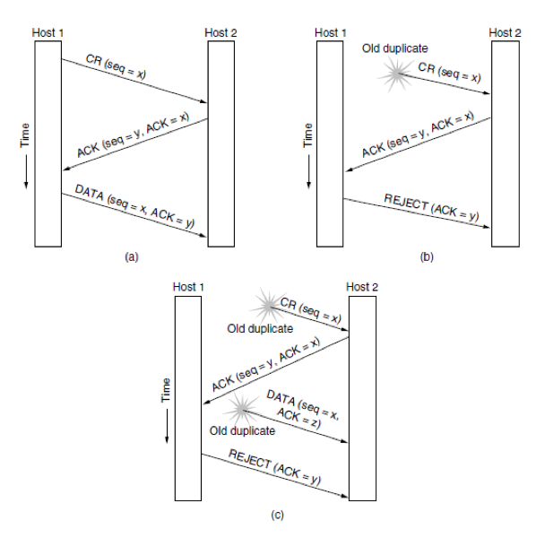
Answer:
Look at the second duplicate packet in Fig. 6-11(b). When the packet arrives, it would be a disaster if acknowledgements to y were still floating around.

Slide 12
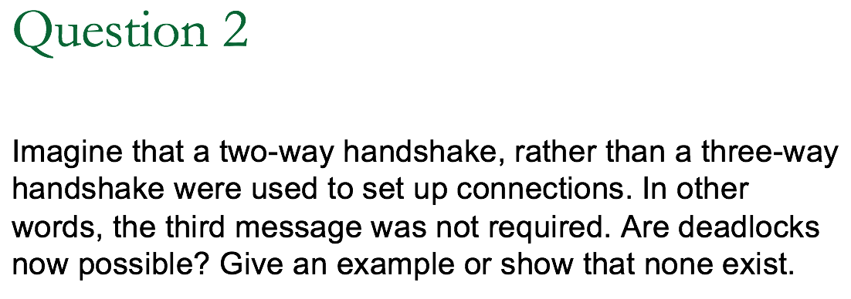
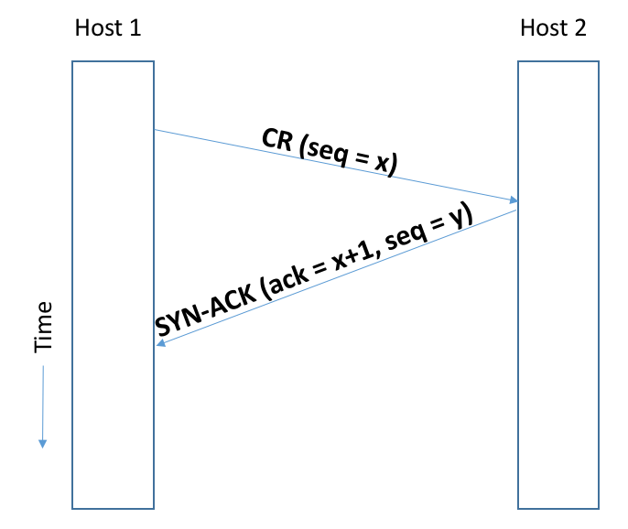
Answer:
Deadlocks are possible.
For example, a packet arrives at A out of the blue, and A acknowledges it. The acknowledgement gets lost, but A is now open while B knows nothing at all about what has happened. Now the same thing happens to B, and both are open, but expecting different sequence numbers.
Timeouts have to be introduced to avoid the deadlocks.
waiting
OPEN
Notes:
Deadlock: both sides are open and wait for sth, and both take no action.

Slide 13
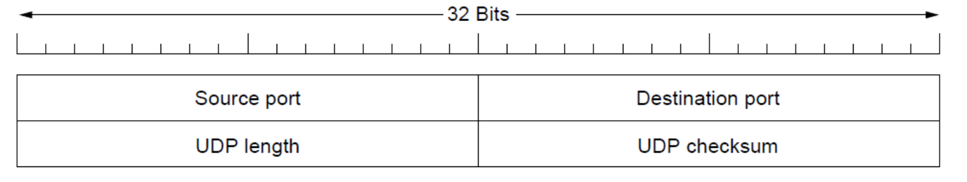

Answer:
No. IP packets contain IP addresses, which specify a destination machine.
Once such a packet arrived, how would the network handler know which process to give it to? UDP packets contain a destination port.
This information is essential so they can be delivered to the correct process.

Slide 14
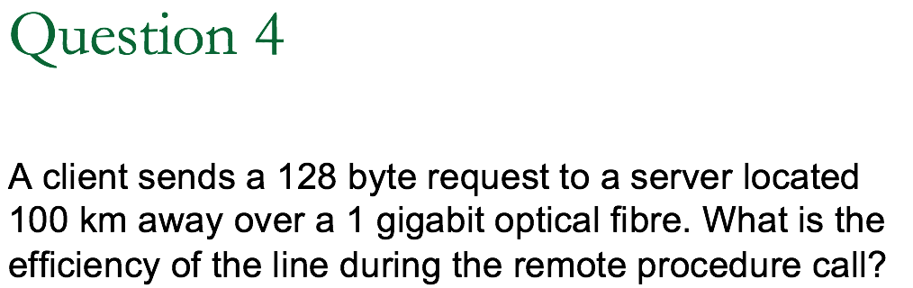
1 gigabit = 10⁹ bits
Assuming propagation speed in fibre is 2/3 the speed of light, 2×10⁸ m/s
efficiency = transmission delay / (transmission delay + propagation delay)
Transmission delay is how long it takes to get all the bits into the wire in the first place (it's packet_length/data_rate).
Sending 1024 bits over a 1 Gbps line takes about 1024/10⁹ = 10⁻⁶s = 1 µs
propagation speed = 2×10⁸ m/s, then the propagation delay will be: 2×100×10³ m / 2×10⁸ m/s = 1 ms
Efficiency = 1 µs / 1 ms = 0.1%

Slide 15
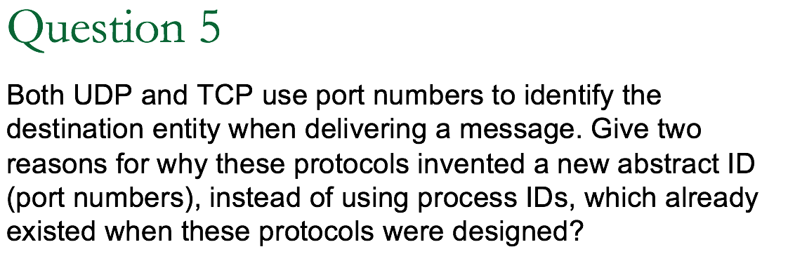
Answer:
Here are three reasons.
First, process IDs are OS-specific. Using process IDs would have made these protocols OS-dependent.
Second, a single process may establish multiple channels of communications. A single process ID (per process) as the destination identifier cannot be used to distinguish between these channels.
Third, having processes listen on well known ports is easy, but well-known process IDs are impossible.

Slide 16
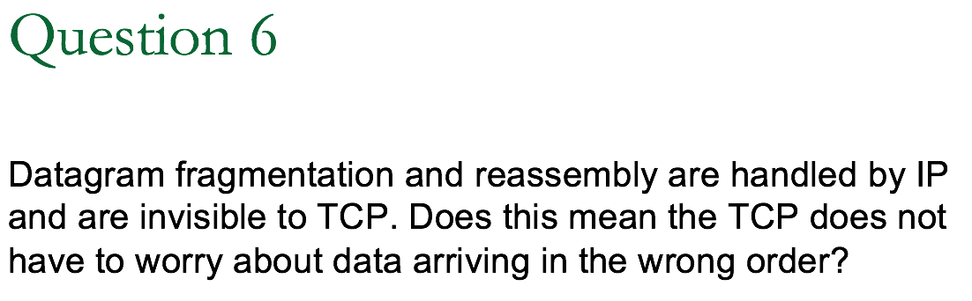
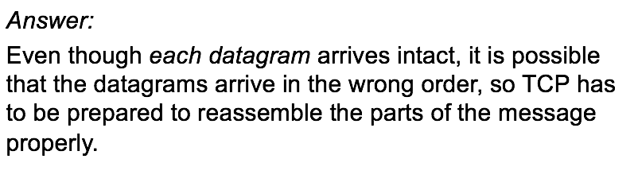

Slide 17
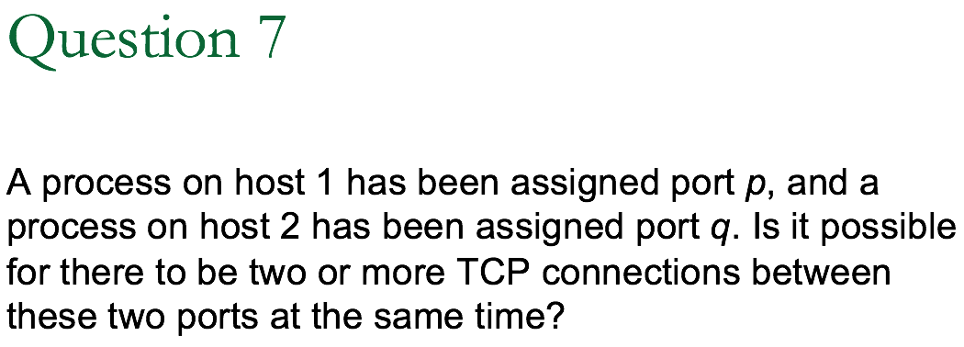
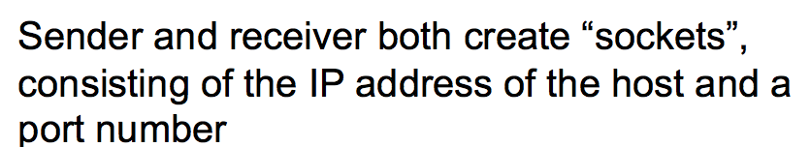
Socket at host 1: (1, p)
Socket at host 2: (2, q)
A connection is identified only by its sockets.
Thus, (1, p) → (2, q) is the only possible connection between those two ports.

Slide 18

Segment payload = frame payload – packet header – segment header
IP packet length
(includes header and payload)

Slide 19

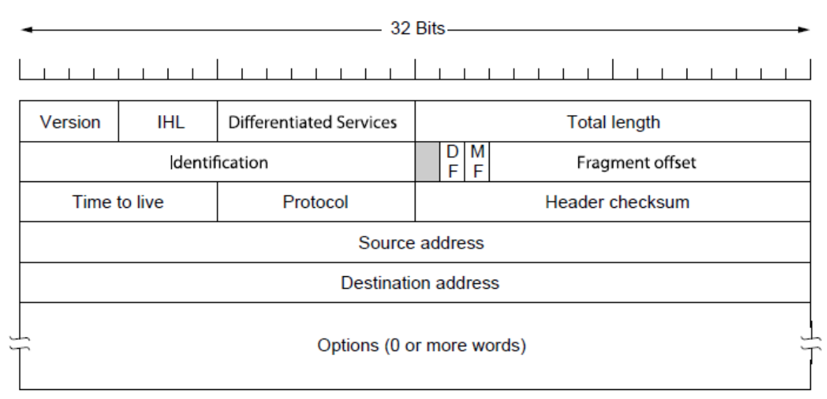
16 bits
The maximum length =
1111111111111111
=65535

Slide 20
Segment payload = frame payload – packet header – segment header
IP packet length
(includes header and payload)
65535 bytes

Slide 21
Minimum IP packet header =
5 * 4 = 20bytes

Slide 22
Minimum TCP segment header =
5 * 4 = 20bytes

Slide 23
Segment payload = frame payload – packet header – segment header
= 65495 bytes
20 bytes
20 bytes
IP packet length
(includes header and payload)
65535 bytes

Slide 24
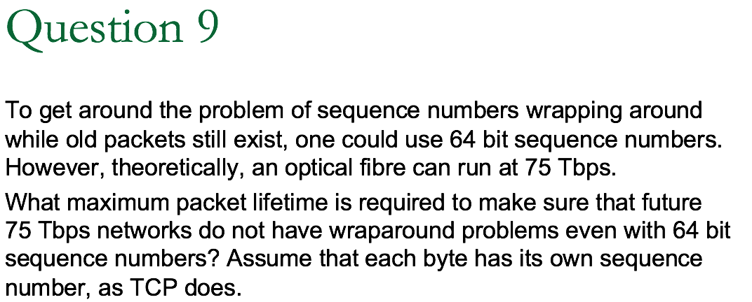
1 Tbps = 10¹²bps = 1.25*10¹¹ bytes/second
Answer:
The sequence space is 2⁶⁴. Each byte is assigned a unique sequence number, so the sequence numbers can represent 2⁶⁴ unique bytes.
A 75 Tbps transmitter can output 9.375×10¹² bytes/s.
t = 2⁶⁴ / 9.375×10¹² = 1.96×10⁶ s = 22.77 days
It takes 22.77 days, which is over three weeks, to wrap around. A maximum packet lifetime of less than 22.77 days will prevent the problem. In short, going to 64 bits is going to work for quite a while.
Notes:
Terabit per second

